Slide 1
Savvy Consumer
Team 1. Pre-purchase research teamAbonohu Mentör: Özlem AKIN - Olivera Çauşi - Vildan Tümay

Slide 3
What research should we do before purchasing? Does the product we buy as a conscious consumer harm the environment? Do I really need it or can I use my old stuff at home for this purpose? Please share your work on pre-purchase research under this heading.
Özlem AKIN

Slide 4
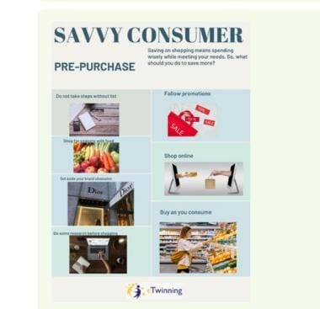
NARİN YGMTAL

Slide 5
Team 1. Pre-purchase research team We as consumers before buying a product should research and think while buying smart. Thinking before you buy often results in more considered purchases and better items. Buying quality means buying less. Buying less is best for all of us. We research when we buy new goods, to help ourselves accomplish a task faster, easier or more affordable. So they do this to make our lives enjoyable by preserving health, the environment, recycling product waste etc. Olivera Ç.

Slide 6
Eyüp.ygmtal S

Slide 8
Savvy Consumer Our research as a consumer before a purchase should be based on several effective points such as: 1. Content and quality evaluation. 2. Design evaluation. The product we will choose is something that should be easily distinguishable from other and attractive products. In other words, the design should attract so much attention from consumers that they stop, consider it and buy it. 3.Packaging evaluation. It is important to make a detailed assessment of the quality of the packaging and its shape. A customer who has never used the product will evaluate it based on the design and packaging 4. Recycling. Product waste to be recycled by being collected in the respective places, in this way we protect the environment, nature and protect the future of humanity. 5. Choosing a product with several functions Student Anisa S. Teacher Olivera Ç.

Slide 10
Team 1. Pre-purchase research team We as consumers have different preferences regarding the products we buy and the ones we need. But are these products harmful to the environment around us, including packaging? As a conscious consumer we need to do some preliminary research on the products we need to buy. For example, if we buy food products they are put in a plastic bag. The plastic bag is harmful to the environment, it pollutes it. In addition to plastic bags we can use something else for them and recycled. So we help ourselves by not spending but also the environment from pollution. From the research we will do about the products we need to make sure that those products are not at all or slightly harmful to the environment. A conscious consumer is one who thinks for the good of himself and the environment around him .Student Anisa S. Teacher Olivera Ç.

Slide 11
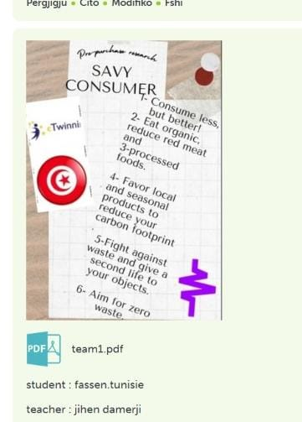
hassen Tunisie

Slide 13
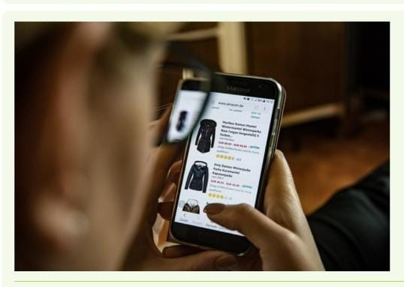
Mahir Serpil

Slide 14
